Slide 1

Bank system
Python programm to do some bank funktions
Ammar Al-Ghouli
Contact: ammaralghouli100@gmail.com

Slide 2
Programm structure

Slide 3
User
BankAccount
CheckingAccount
SavingsAccount

Slide 4

Programm structure
The code utilizes inheritance to create a hierarchy of classes.
User class: Serves as the base class, containing attributes like name and pin for user authentication.
Attributes:
name (str): User's name
pin (int): User's 4-digit PIN for authentication
Methods:
authenticate(self, entered_pin): Verifies if the entered PIN matches the user's pin

Slide 5


Programm structure
BankAccount class: Inherits from User, adding functionalities related to accounts (balance, transactions).
Attributes:
account_number (int): Unique account number
balance (float): Current account balance
account_type (str): Account type (Savings or Checking)
transaction_log (list): List to store transaction history
Methods:
get_balance(self): Returns the current account balance.
log_transaction(self, message): Records a transaction message with timestamp and appends it to the transaction log.
write_transaction_log_to_file(self): Writes the transaction log to a file specific to the account number.
read_transaction_log(self): Reads the transaction log from the file and returns a list of transactions.

Slide 6

Programm structure
SavingsAccount class: Inherits from BankAccount, specific to savings accounts with an interest rate.
Attributes:
interest_rate (float): Interest rate applicable to the savings account
Methods:(Inherits all methods from BankAccount) deposit(self, amount):
Deposits funds into the account, updates balance, and logs the transaction.
Validates the deposit amount to be positive.

Slide 7
Programm structure
CheckingAccount class: Inherits from BankAccount, specific to checking accounts with overdraft limits
Attributes:
overdraft_limit (float): Maximum amount a checking account can be overdrawn
Methods:(Inherits all methods from BankAccount) deposit(self, amount):
withdraw(self, amount): Withdraws funds from the account, updates balance, and logs the transaction.Validates the withdrawal amount to ensure sufficient funds are available (including overdraft limit)
deposit(self, amount): Deposits funds into the account, updates balance, and logs the transaction.Validates the deposit amount to be positive
transfer(self, to_account_number, amount): Transfers funds from this account to another account.Validates the transfer amount to be positive.Verifies the recipient account number is valid.
Checks for sufficient funds considering the overdraft limit.
Performs the transfer by debiting this account and crediting the recipient account
Logs the transaction in both accounts.

Slide 8
Programm structure
BankSystem Class Manages accounts and user interactions
Attributes:
accounts (dict): Dictionary to store accounts (key: account number, value: BankAccount object)
Methods:
generate_account_number(self): Generates a unique account number (Note: This implementation is a simple example and should be replaced with a more robust approach)
create_account(self, name, pin, account_type, starting_balance, interest_rate=0.01, overdraft_limit=0): Creates a new account based on the provided information.
get_Account(self, account_number): Retrieves an account object based on the account number.
authenticate_user(self, account_number, entered_pin): Verifies user credentials and returns the authenticated account object.

Slide 9


Programm structure
load_accounts_from_file(self): Loads account data from a text file (if it exists) into the accounts dictionary.
write_accounts_to_file(self): Writes account data from the accounts dictionary to a text file.
manage_account(self, account): Provides an interactive menu for the user to manage their account (view balance, deposit, withdraw, transfer, view transaction log).
transfer(self, to_account_number, amount): Transfers funds from this account to another account.Validates the transfer amount to be positive.Verifies the recipient account number is valid.
Checks for sufficient funds considering the overdraft limit.
Performs the transfer by debiting this account and crediting the recipient account
Logs the transaction in both accounts.

Slide 10
Code Breakdown

Slide 11
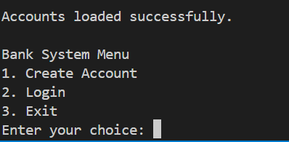
Code Breakdown I have used this modules
1-dateTime
2- UUID
3- Json

Slide 12
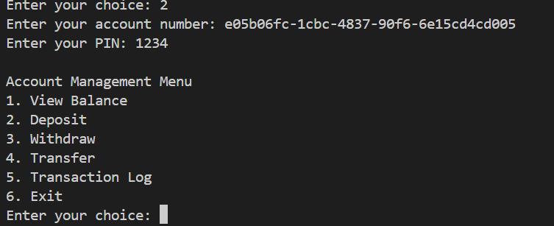
Account Management Menu
1. View Balance
2. Deposit
3. Withdraw
4. Transfer
5. Transaction Log
6. Exit

Slide 13

Thanks a lot!
Contact
Ammar Al-Ghouli Information System Engineer
ammaralghouli100@gmail.com

